Slide 1
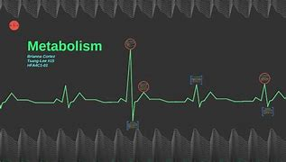
IIT EXTREME METABOLISM PAPERS
Daham aljorani
19444664

Slide 2
Background
Explain the specific relevant background necessary for the question/research
Active recovery
blood lactate
intensity
Exercise
Explain why the research question or aim of the study is important.
High-intensity exercise training aids the production and accumulation of blood lactate, which is then released by good recovery. However, when it comes to removing accumulated blood lactate, there is no universally accepted intensity or mode. We looked at clearance of accumulated blood lactate during recovery after high-intensity interval runs at various exercise intensities at or below the threshold.

Slide 3
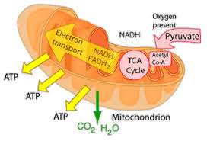
What is lactic acid and how is it produced
Glycogen
Glucose Gluose-6-phosphate
Lactic acid Fructose -6-phosphate
pyruvate
During exercise, glycogen and glucose are broken down into pyruvate, which is then converted into atp.
Pyruvate may either be reduced to lactic aicd or join the mitochondria for oxidation (aerobic or metabolic processes involving O2) (anaerobic metabolism).
Latic acid is a weak acid and rapidly dissociate into lactate and hydrogen ions, so there's never much lactic acid in the muscle and even less in blood

Slide 4
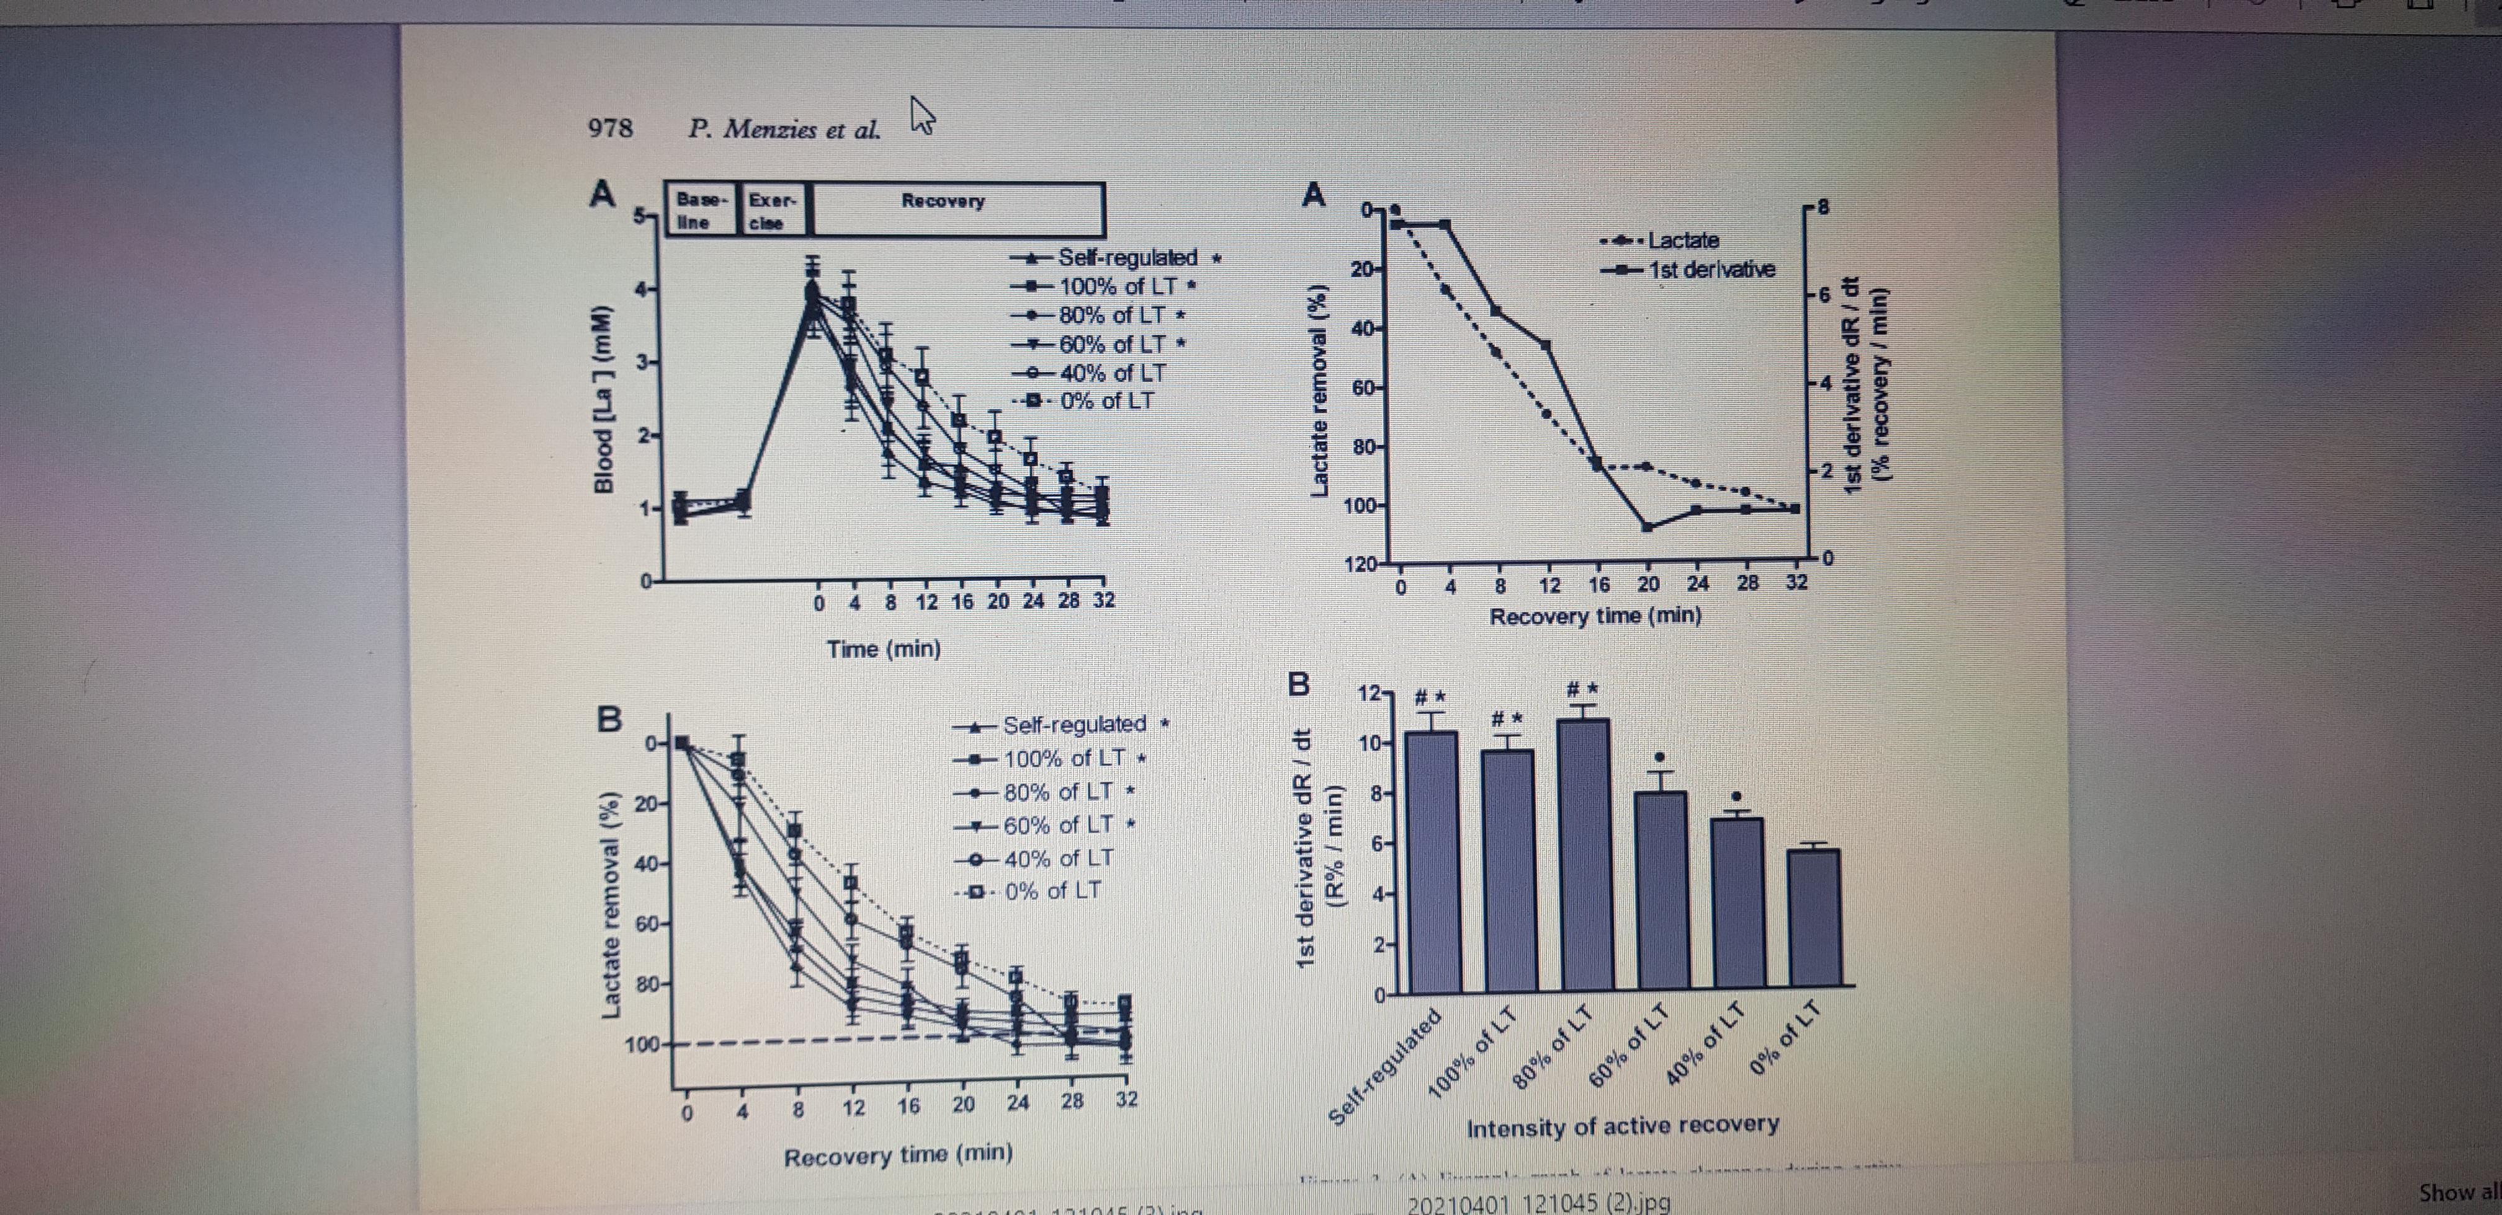
Does lactic acid or lactate affect recovery
No! delayed muscle soreness is caused by
Sensitised nocireceptors
Ultrastructural muscle damage
Inflammation
No studies have found a relationship between lactate and, muscle soreness

Slide 5
Does lactic acid or lactate affect recovery
Why are your research question's results so physiologically specific? Is there any other literature that supports or contradicts your findings, and are there any gaps or flaws in the literature that addresses this research question?
With rising exercise speed, oxygen absorption and consumption increases linearly.
Lactate does not rise in a linear fashion, but rather remains constant until aerobic metabolism can no longer support the workload. The lactate threshold is reached when anaerobic metabolism kicks in, and blood lactate increases exponentially.
Because lactic acid (and subsequently lactate) is produced as fatigue develops people wrongfully claim it is a cause of fatigue at high workloads

Slide 6
So does lactic acid really cause fatigue?
Lactic acid, on the other hand, does not, and lactate is an important source of energy for skeletal muscle, the heart, brain, kidneys, and liver.
Lactate is transported from fast twitch fibre to slow twitch fibre, which can convert it back to pyruvate and oxidise it for ATP!
No way! Lactic acid, on the other hand, does not, and lactate is a valuable fuel source for skeletal muscle, the heart, the brain, the kidneys, and the liver.
Increases in phosphate (P), altered rations of high-energy phosphate, and reactive oxygen species, among other factors, are believed to be the cause of fatigue in people who work hard.

Slide 7
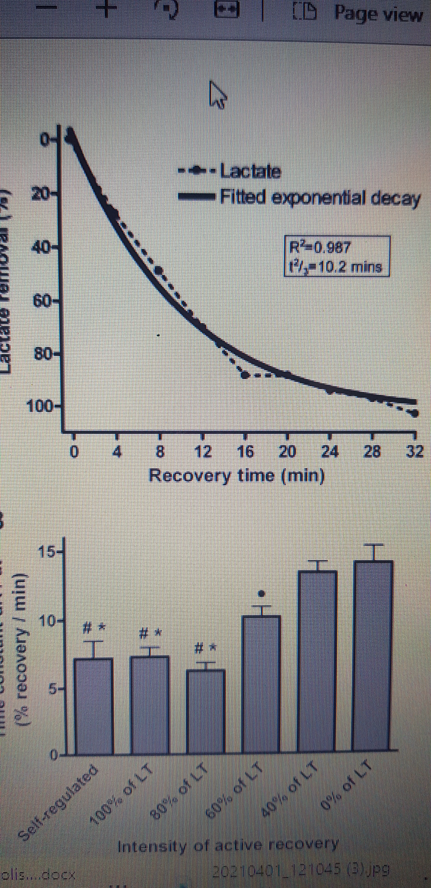
Then why do some athletes measure lactate threshold
VO2 max is a measure of an athlete's maximum capacity, while VO2 at lactate threshold, also known as pace/power at lactate threshold, is a measure of an athlete's current ability.
VO2 max is minimally trainable in well trained athletes, whereas lactate threshold has been shown to undergo more measurable improvements with training
This means that whilst VO@ max might not change with training, the ability to perform at a higher workload before lactate accumulation can be trained and measured

Slide 8
What lactic can do
Neither lactic acid nor lactate are direct causes of fatigue at higher workloads
Lactate is an important source of energy in working and non-working tissue, as well as the heart, brain, liver, and kidneys.
The cause of delayed onset muscle soreness (DOMS) is multifaceted, however does not include lactic acid or lactate
Lactate threshold is measurable and trainable variable that can help to monitor training adaptation

Slide 9
References
Andrews, M. A., Godt, R. E., & Nosek, T. M. (1996). Influence of physiological lactate concentrations on contractility of skinned striated muscle fibres of rabbit. Journal of Applied Physiology, 80, 2060–2065.
Belcastro, A., & Bonen, A. (1975). Lactic acid removal rates during controlled and uncontrolled recovery exercise. Journal of Applied Physiology, 39, 932–936
Lee, I. M., Sesso, H. D., Oguma, Y., & Paffenbarger, R. S., Jr. (2003). Relative intensity of physical activity and risk of coronary heart disease. Circulation, 107, 1110–1116.
Moholdt, T., Wisloff, U., Nilsen, T. I., & Slordahl, S. A. (2008). Physical activity and mortality in men and women with coronary heart disease: A prospective population-based cohort study in Norway (the HUNT study). European Journal of Cardiovascular Prevention and Rehabilitation, 15, 639–645.
Tjonna, A. E., Lee, S. J., Rognmo, O., Stolen, T. O., Bye, A., Haram, P. M. et al. (2008). Aerobic interval training versus continuous moderate exercise as a treatment for the
Westerblad, H., & Allen, D. G. (1992). Changes of intracellular pH due to repetitive stimulation of single fibres from mouse skeletal muscle. Journal of Physiology, 453, 413–434.
Newell, J., Higgins, D., Madden, N., Cruickshank, J., Einbeck, J., & McDonald, R. (2007). Software for calculating blood lactate endurance markers. Journal of Sports Sciences, 25, 1403–1409.
Dodd, S., Powers, S. K., Callender, T., & Brooks, E. (1984). Blood lactate disappearance at various intensities of recovery exercise. Journal of Applied Physiology, 57, 1462–1465.
Gollnick, P. D., Bayly, W. M., & Hodgson, D. R. (1986). Exercise intensity, training, diet and lactate concentration in muscle and blood. Medicine and Science in Sports and Exercise, 18, 334–340
Haram, P. M., Kemi, O. J., Lee, S. J., Bendheim, M. O., AlShare, Q. Y., Waldum, H. L. et al. (2009). Aerobic interval training vs. continuous moderate exercise in the metabolic syndrome of rats artificially selected for low aerobic capacity. Cardiovascular Research, 81, 723–732.

